Slide 1
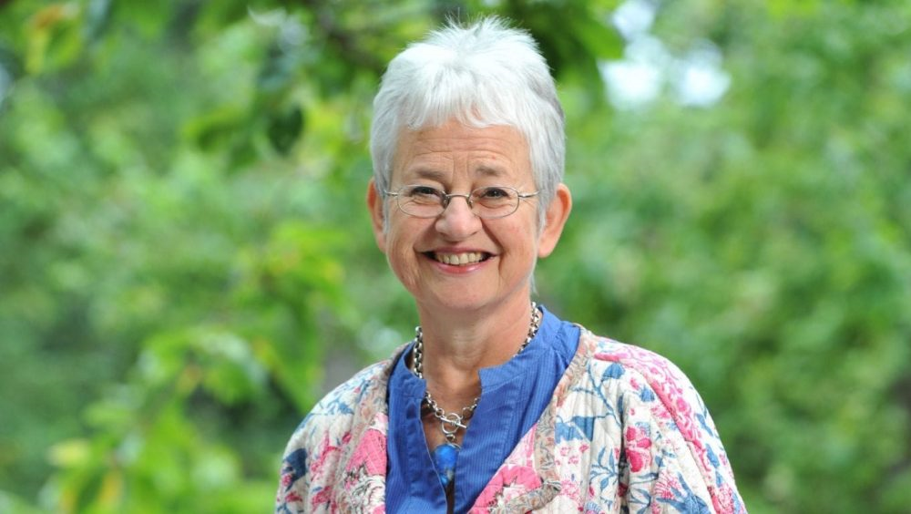
Jacqueline Wilson
All about Jacqueline’s life

Slide 2
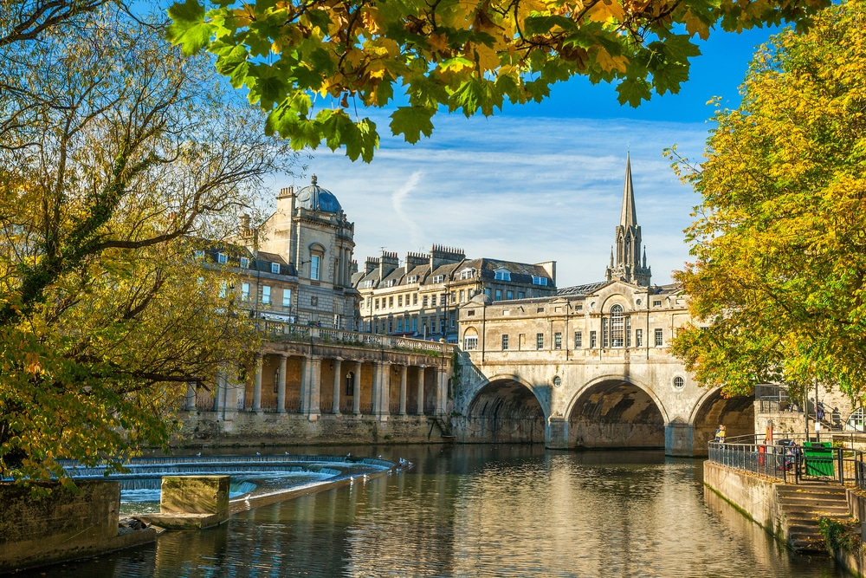
Jacqueline was born in Bath on 17th December 1945 and was Christened Jacqueline Aitken. She became Jacqueline Wilson when she got married in 1945. She is married to William Millar Wilson. This is a picture of Bath.

Slide 3
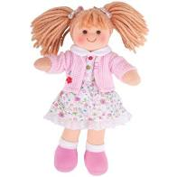
When she was young, Jacqueline Wilson used to love playing with her grandma. They made outfits for all of Jacqueline’s dolls.

Slide 4
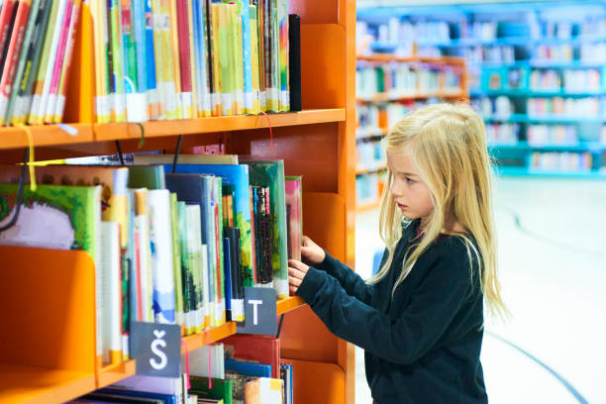
Jaqueline was an only child but she longed for a jolly older brother. She loved going to the library to pick books, but was not happy when the one she wanted to read wasn’t there.

Slide 5
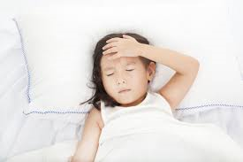
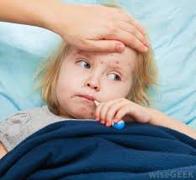
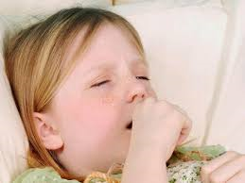
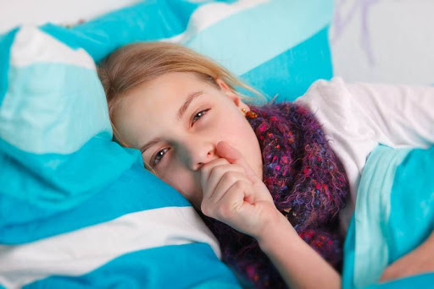
When Jacqueline Wilson started school she did not have a very nice time as she was ill nearly all the time. She had whooping cough and the measles and had a good bit of school time of.

Slide 6
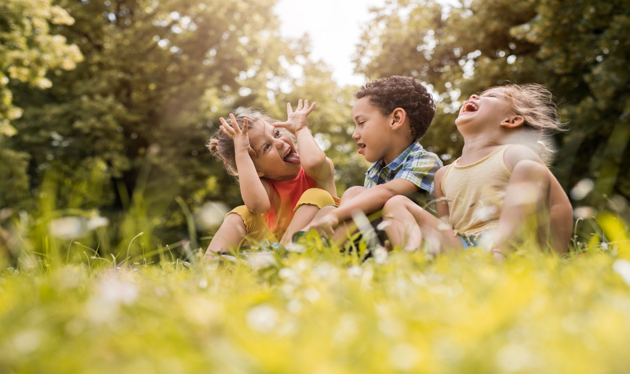
When Jacqueline Wilson was young she would act out some very silly games. Some were so silly even her friends couldn’t join in!

Slide 7
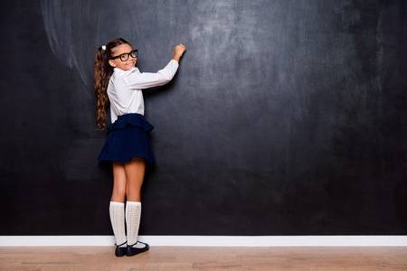
When she was at school Jacqueline was really, really good at English and pretty good at Art and History. But she HATED Games!!!!She was ok at Math and Science. During Math lessons Jacqueline would usually sit, stare out the window and think of stories. Her Teacher called her Jackie Daydream

Slide 8
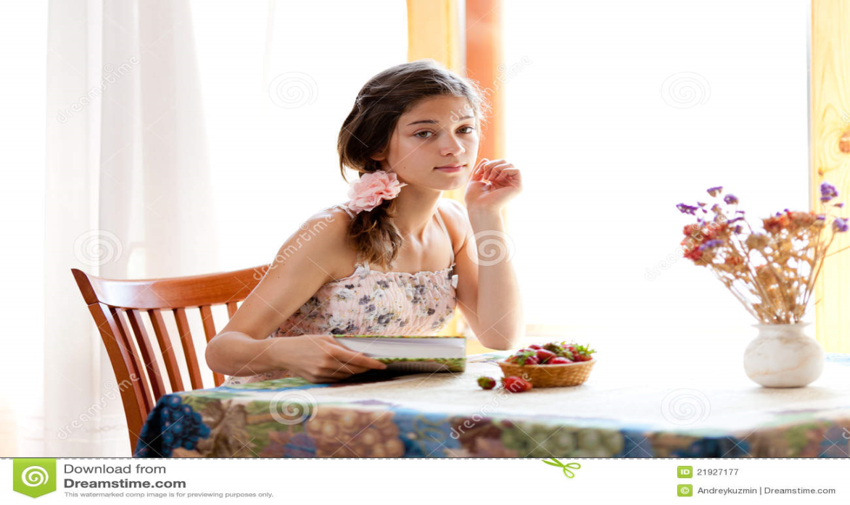
Jacqueline left school at the age of 16 and began to train as a secretary. But instead of becoming one she started working for a Dundee-based publishing company DC Thomson working on a new Teenage girls’ magazine, Jackie, which was named after her.

Slide 9
Jacqueline first started writing books for adults but publishers would not sell them. Then Jacqueline had a daughter, Emma Wilson .When Emma was still young Jacqueline wrote Ricky’s Birthday her first ever children’s published book. At the time she had five adult crime novels published, but she knew she didn’t want to write for adults. She wanted to write for children.

Slide 10
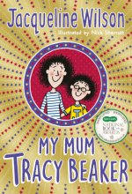
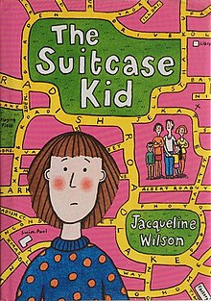
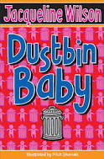
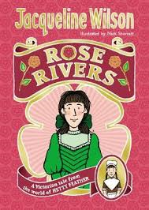
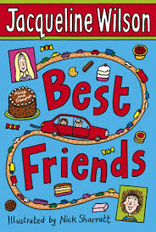
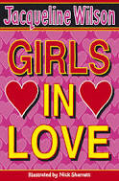
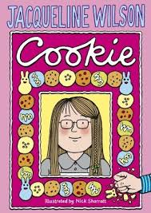
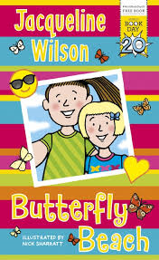
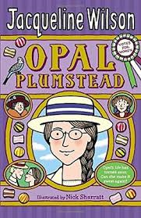
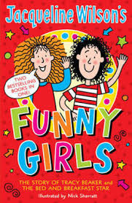
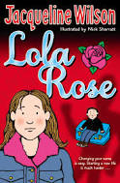
Jacqueline normally wrote stories from a child’s point of view. Most of her stories were about things that affect a child’s life e.g. Dead mother, foundling /orphan, poor people and other things like that. Here are the front covers of some of Jacqueline’s books.

Slide 11
Jacqueline Wilson Fun Facts
Jacqueline starts her day by swimming 50 lengths of her local swimming pool
As well as writing Jacqueline gives talks at book shops, goes to meetings, visits schools and opens her readers’ letters(she gets over 200 each week)
Every time Jacqueline publishes a book she buys new jewellery
She has about 15,000 books in her home
Many of her books are illustrated by Nick Sharratt
Jacqueline won loads of awards for her Tracy Beaker series including the Carnegie Medal and the smarties prize

Slide 12
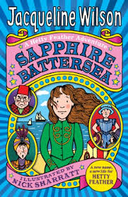
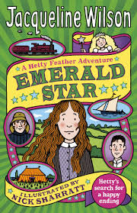
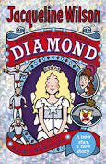
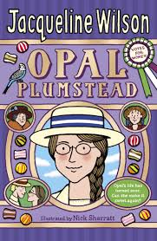
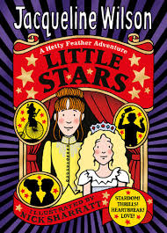
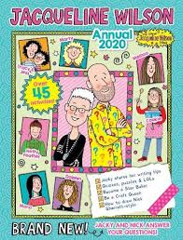
Here are the Jacqueline Wilson books I have read and I own the annual. Little stars is the library’s and the rest my cousins.

